Slide 2
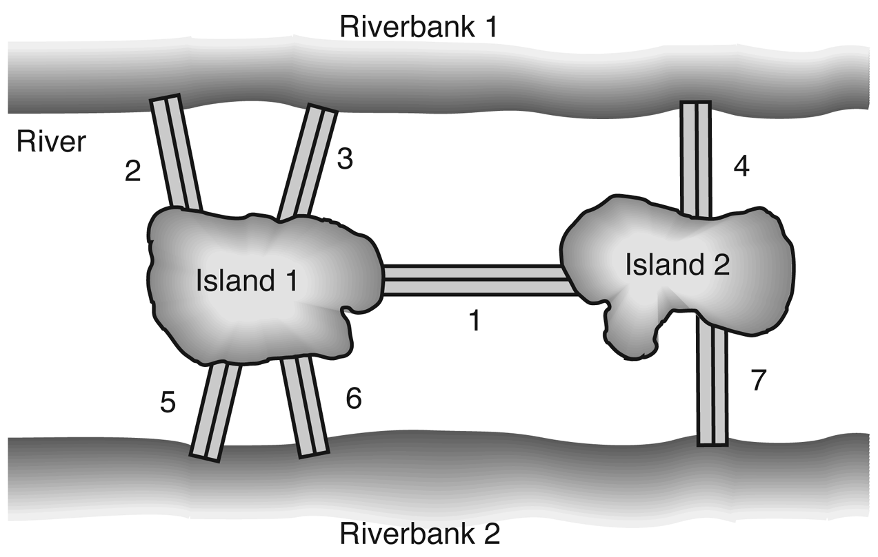
Figure 3.1: The city of Königsberg.

Slide 3
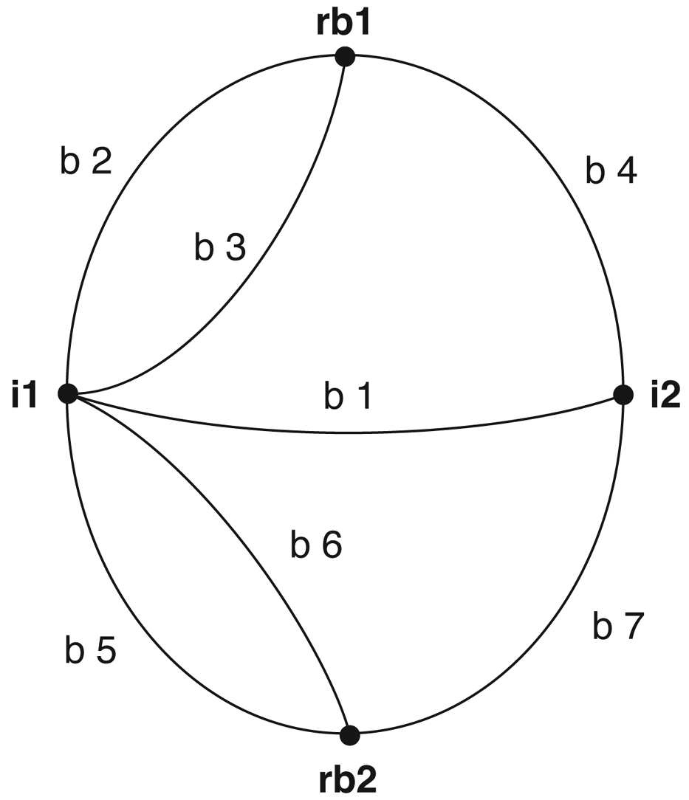
Figure 3.2: Graph of the Königsberg bridge system.

Slide 4
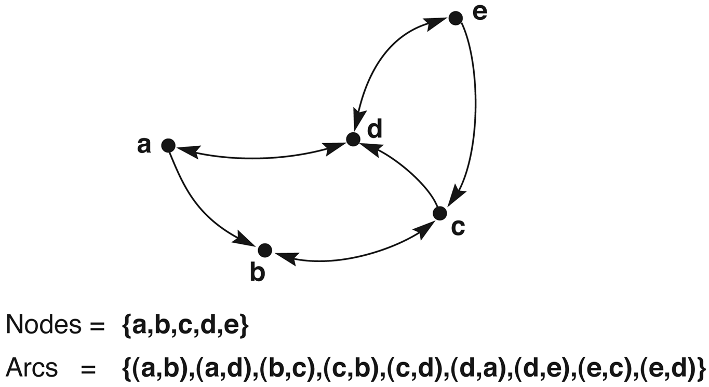
Figure 3.3: A labeled directed graph.

Slide 5
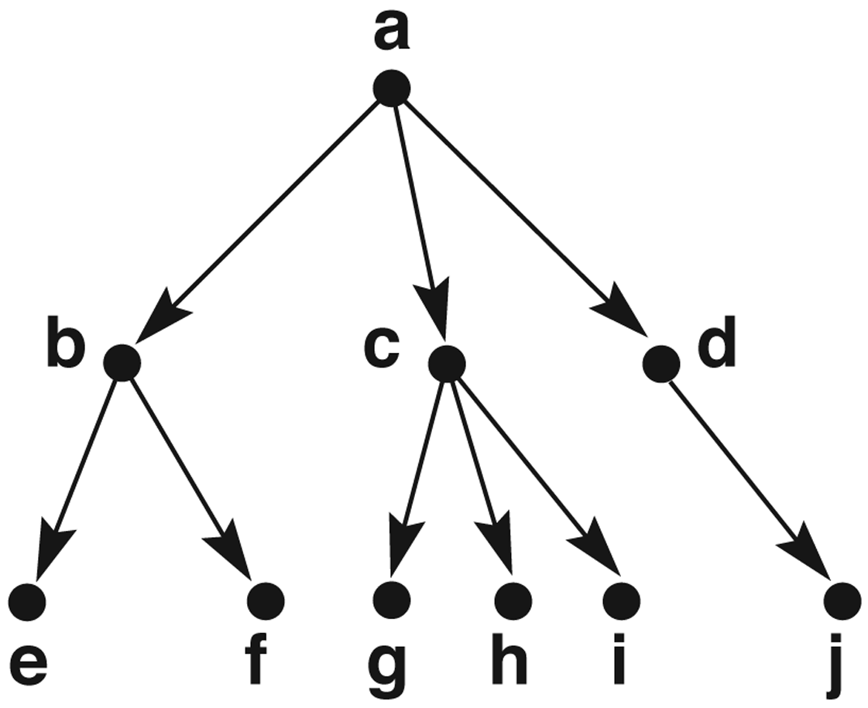
Figure 3.4: A rooted tree, exemplifying family relationships.

Slide 6
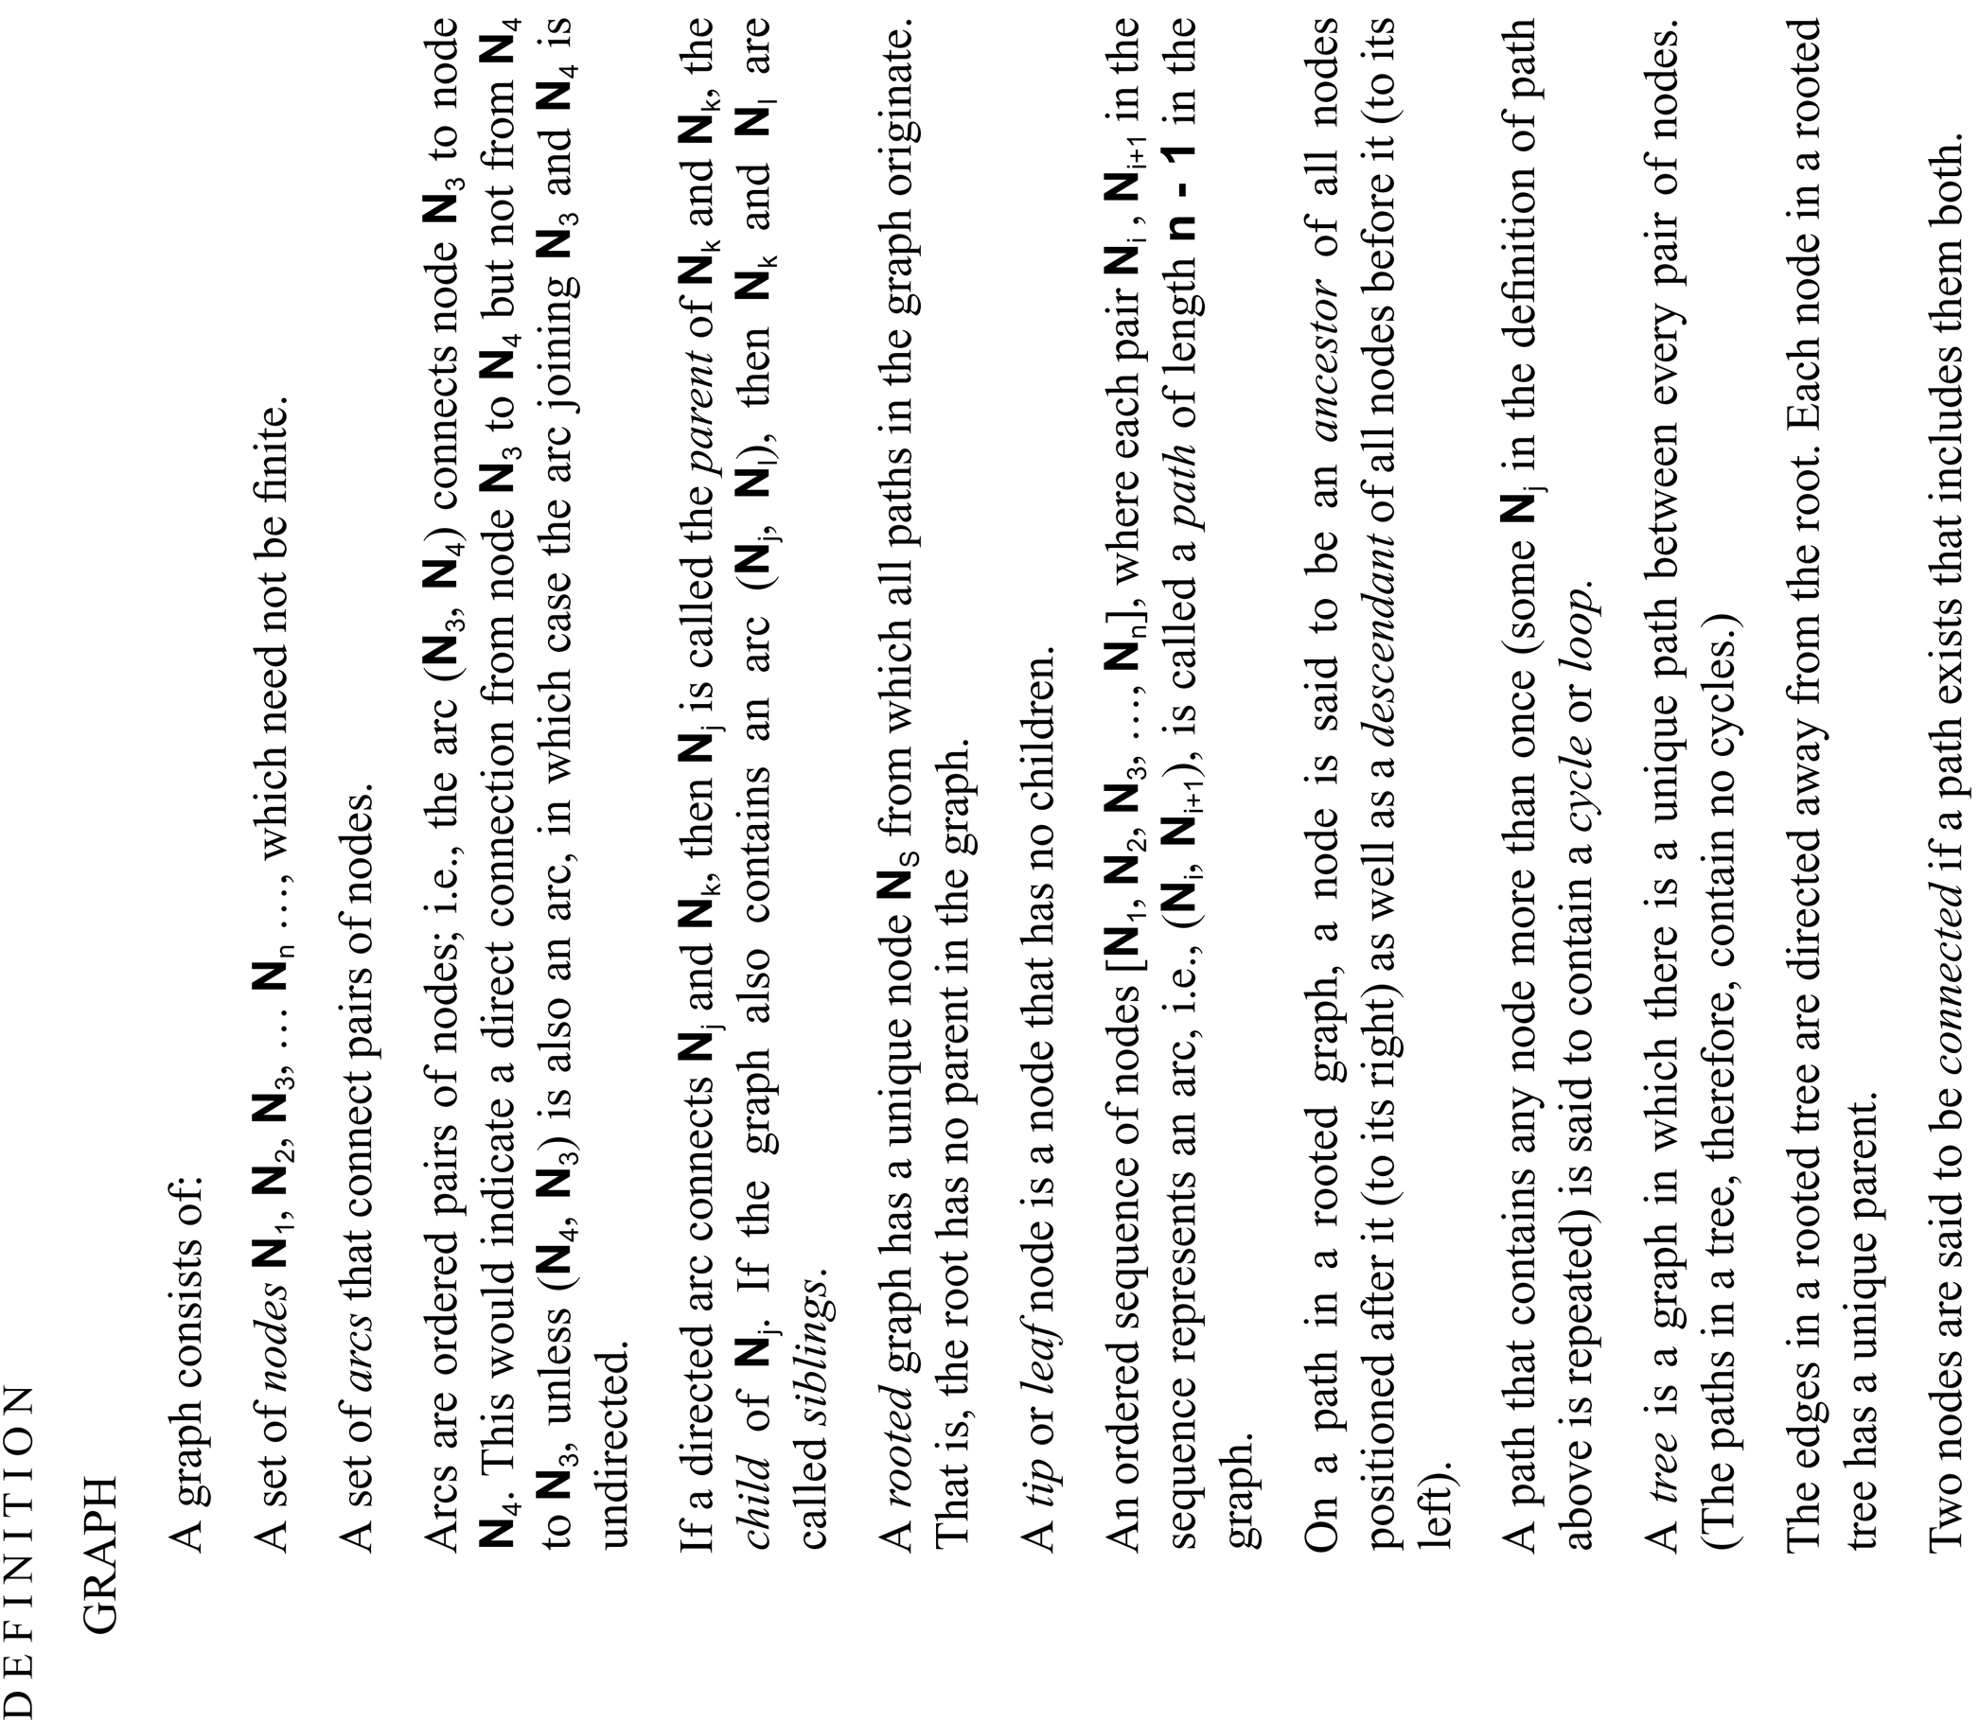

Slide 7
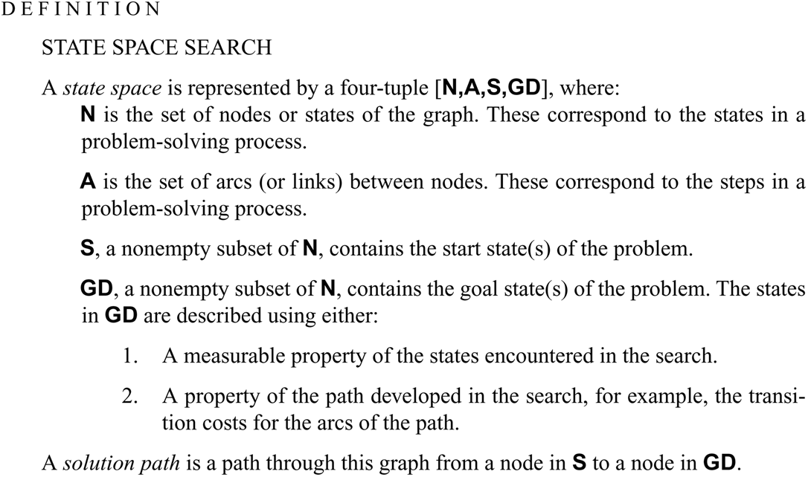

Slide 8
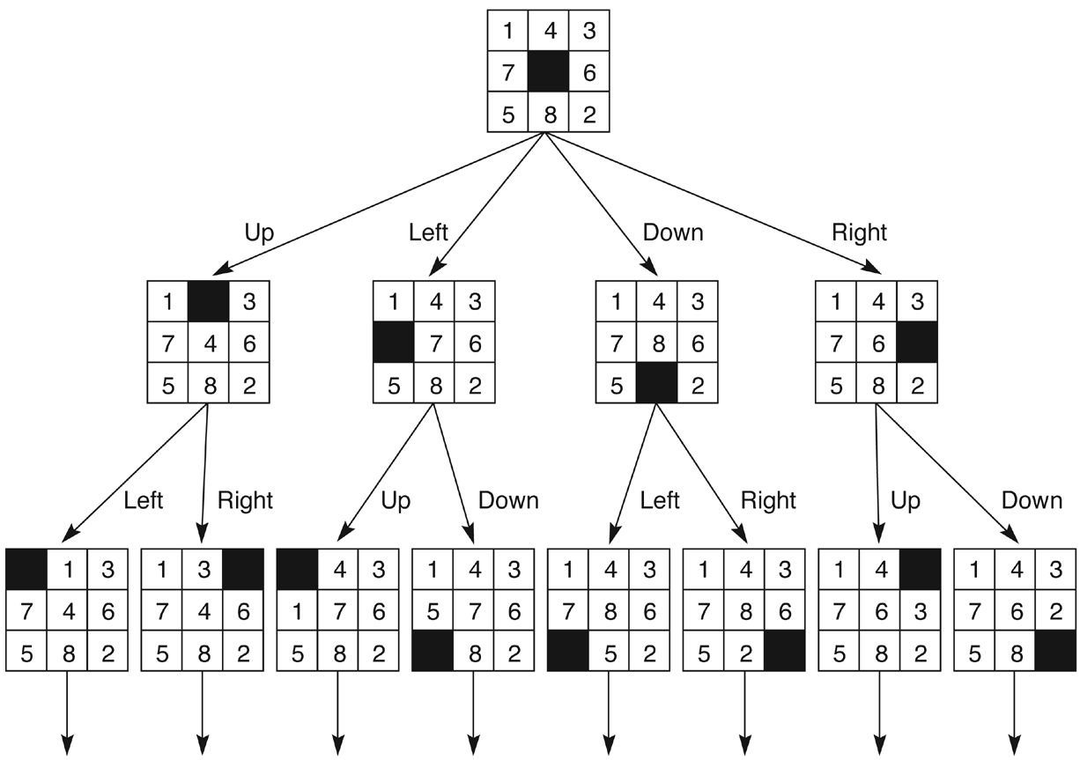
Figure 3.6: State space of the 8-puzzle generated by “move blank” operations.

Slide 9
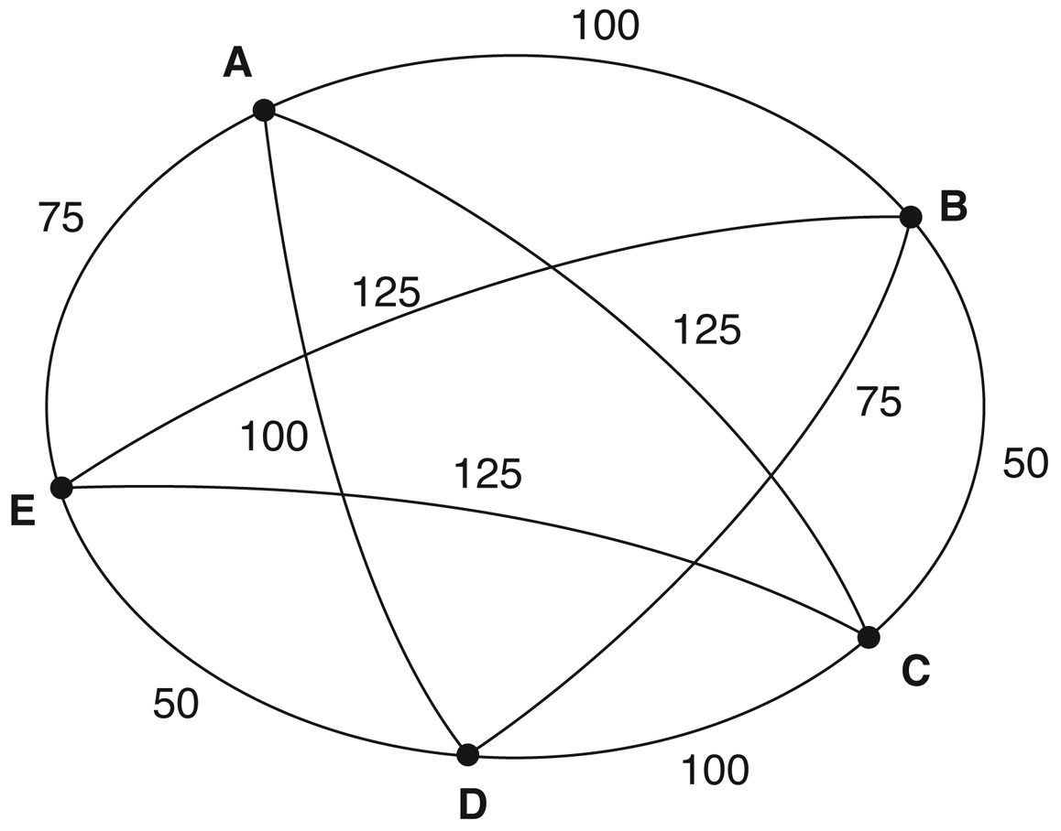
Figure 3.7: An instance of the traveling salesperson problem.

Slide 10
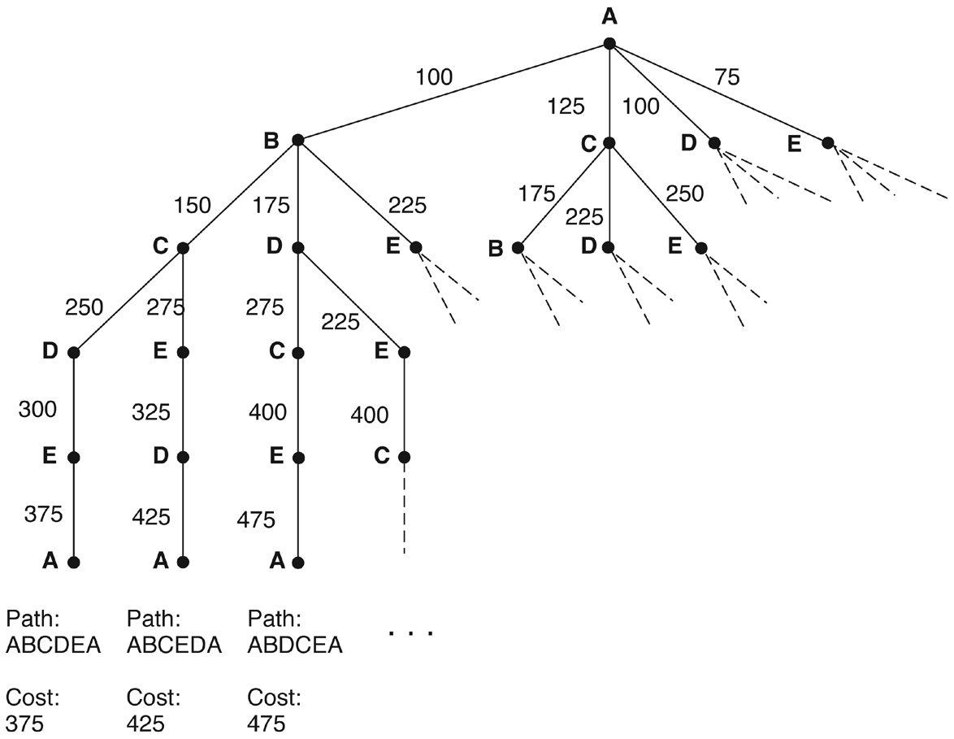
Figure 3.8: Search of the traveling salesperson problem. Each arc is marked with the total weight of all paths from the start node (A) to its endpoint.

Slide 11
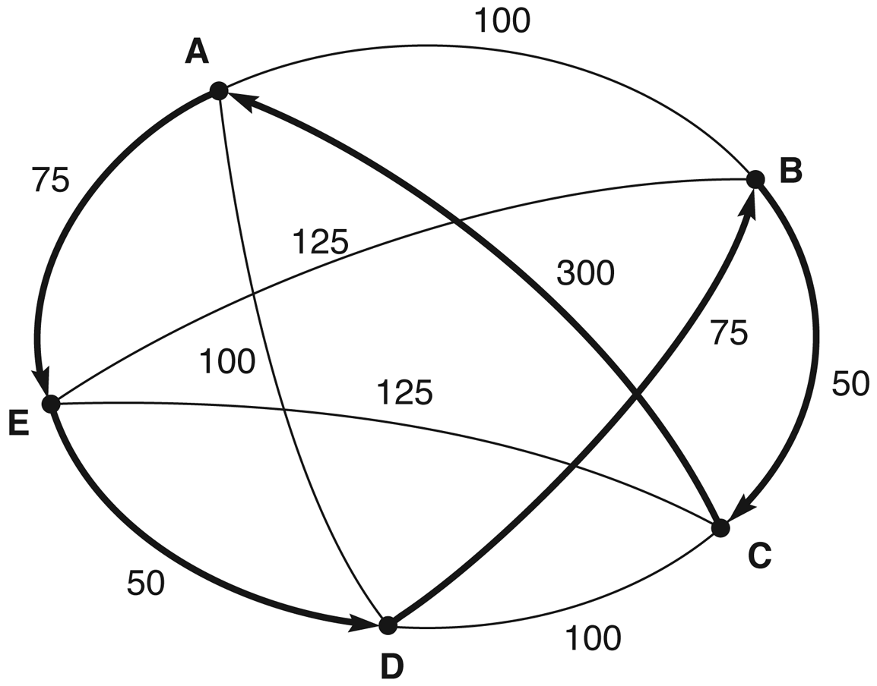
Figure 3.9: An instance of the traveling salesperson problem with the nearest neighbor path in bold. Note that this path (A, E, D, B, C, A), at a cost of 550, is not the shortest path. The comparatively high cost of arc (C, A) defeated the heuristic.

Slide 12
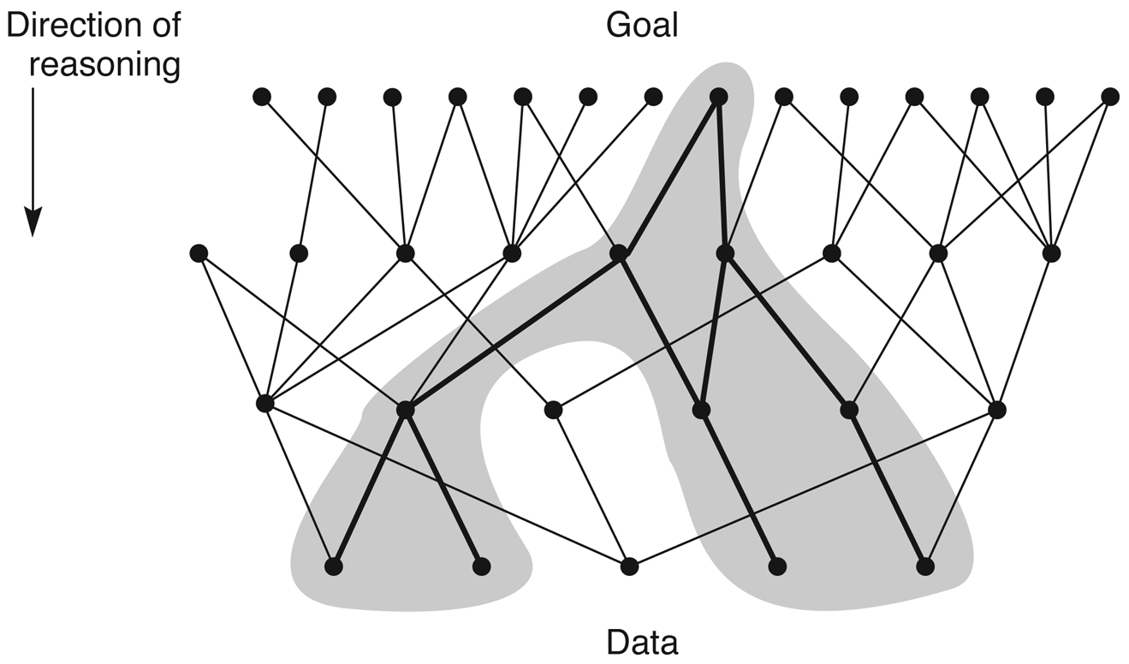
Figure 3.10: State space in which goal-directed search effectively prunes extraneous search paths.

Slide 13
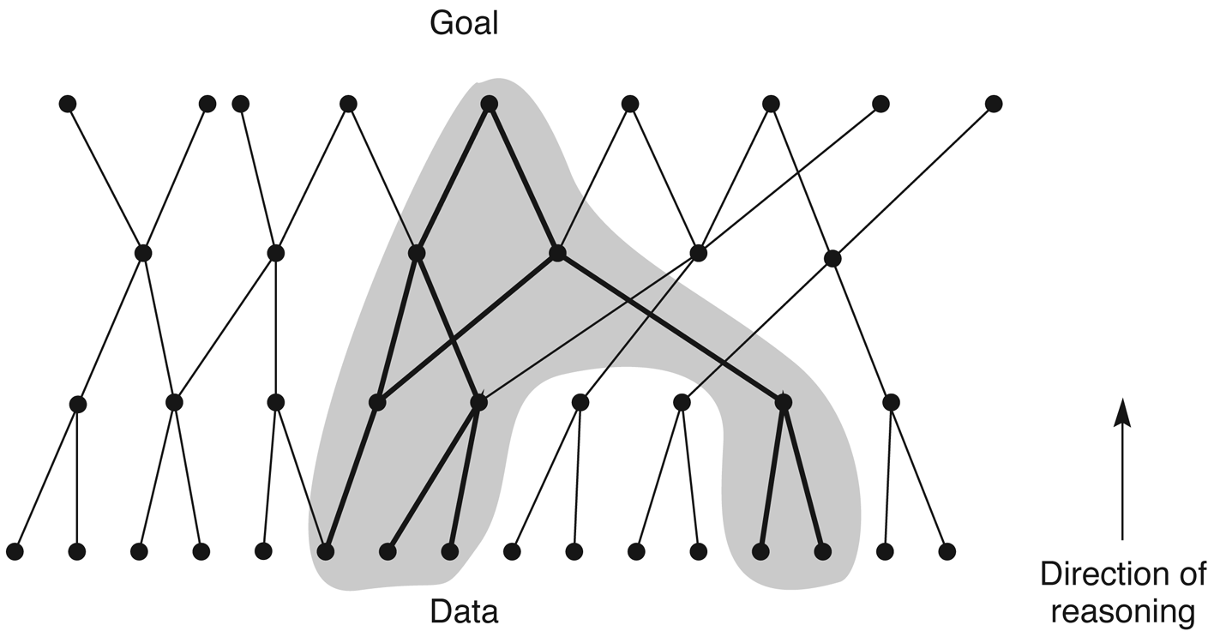
Figure 3.11: State space in which data-directed search prunes irrelevant data and their consequents and determines one of a number of possible goals.

Slide 14
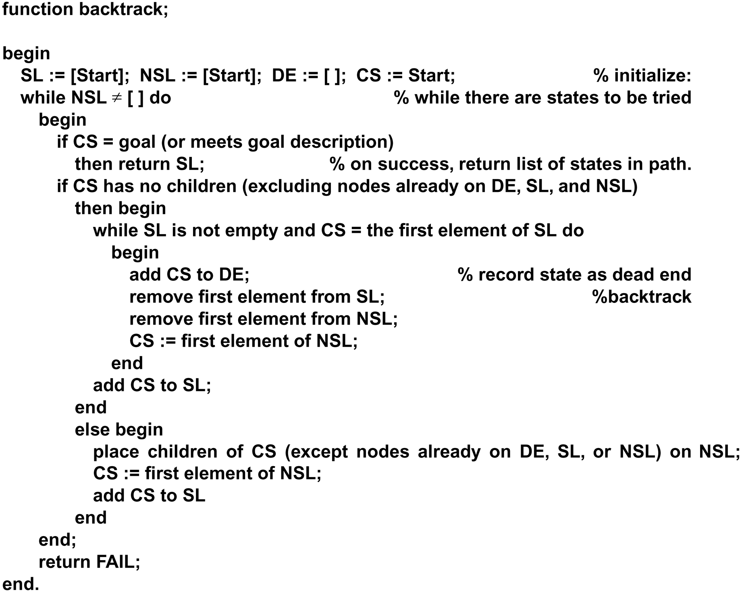
Function backtrack algorithm

Slide 15
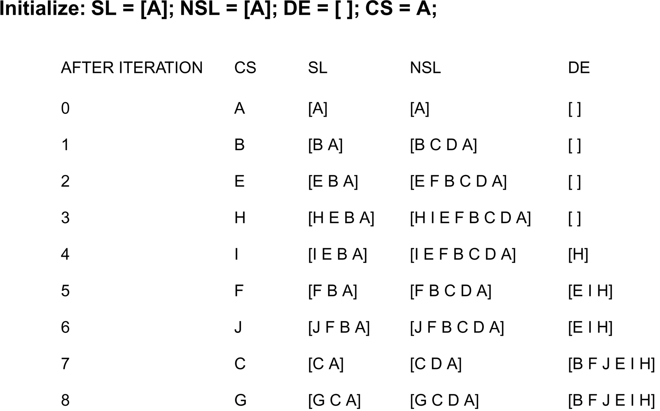
A trace of backtrack on the graph of figure 3.12

Slide 16
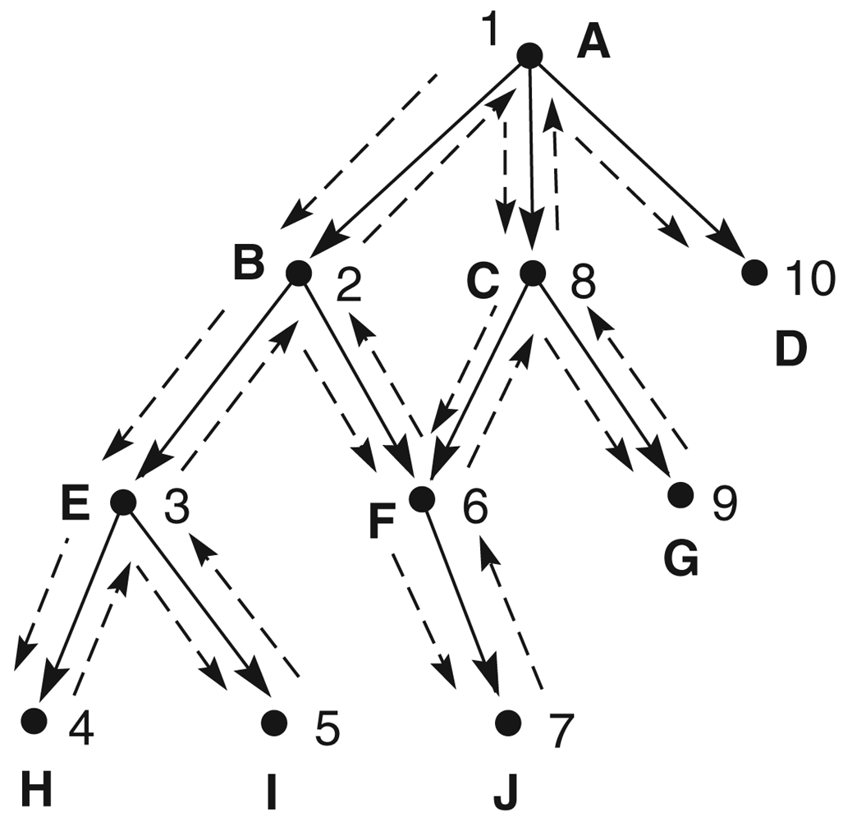
Figure 3.12: Backtracking search of a hypothetical state space.

Slide 17
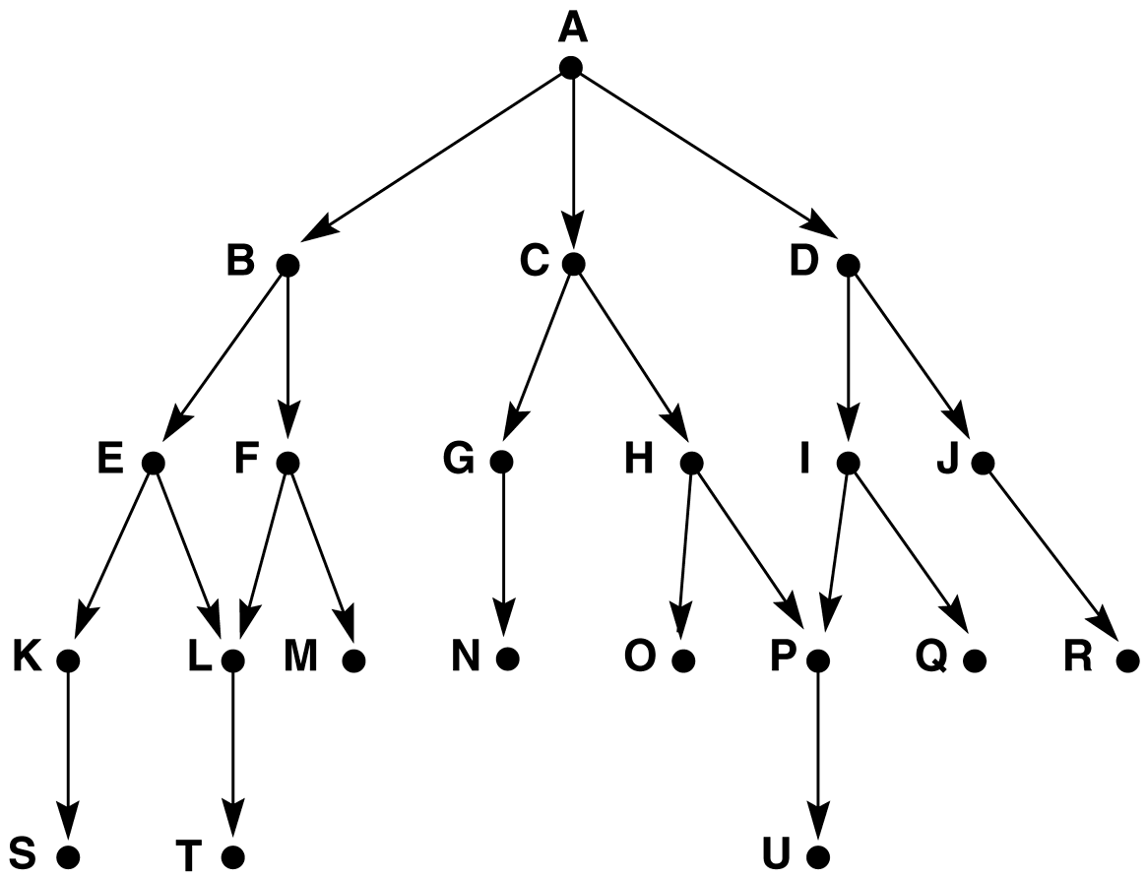
Figure 3.13: Graph for breadth- and depth-first search examples.

Slide 18
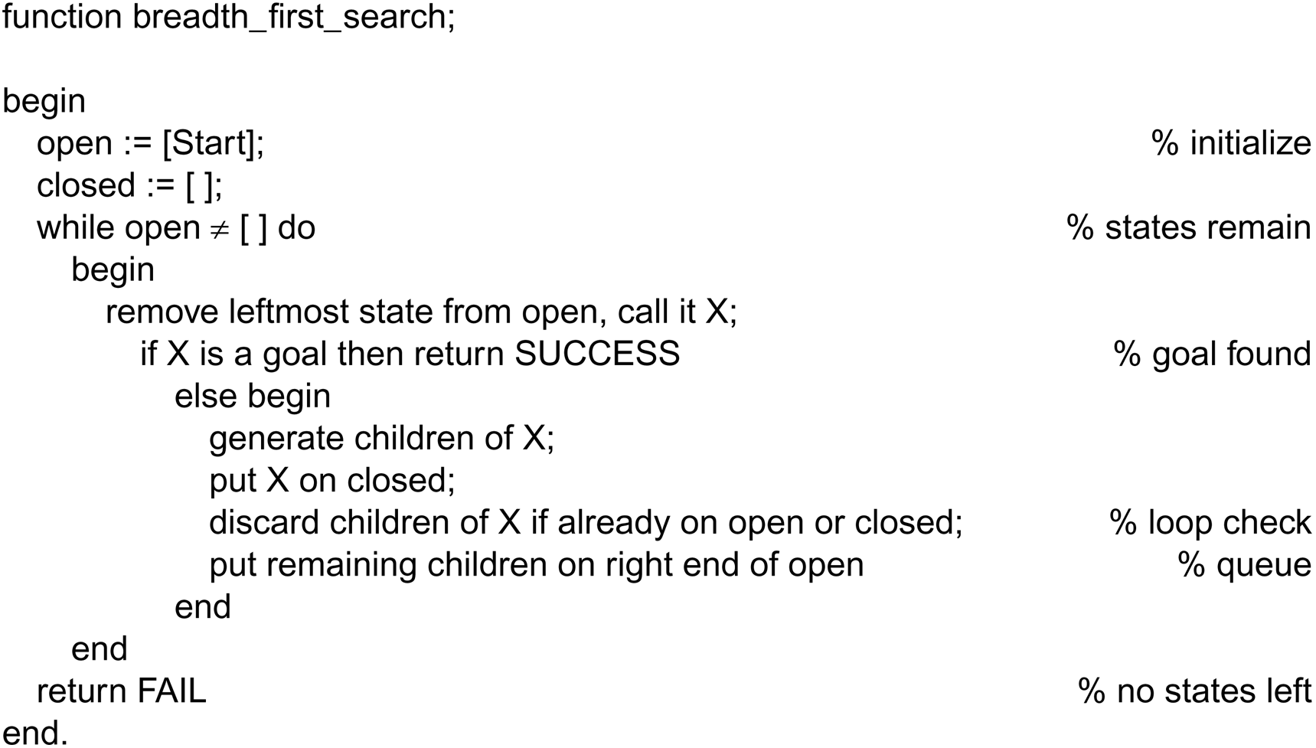
Function breadth_first search algorithm

Slide 19
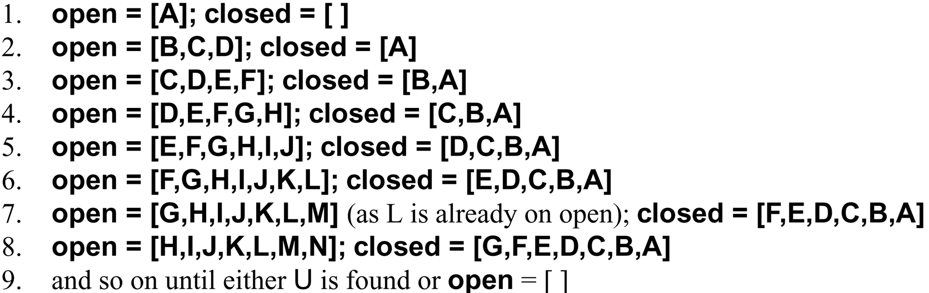
A trace of breadth_first_search on the graph of Figure 3.13

